Slide 1
K.E.V.I.N.
Key Environmental Virtual Intelligence Network
Team 2
Hasanain Alsaid, Ahmad Barakat, Damion Tsosie
Capstone ITEC 490

Slide 2
The Team
Hasanain Alsaid: Lead UI/UX Developer
Ahmad Barakat: Security Architect
Damion Tsosie: UI Solutions Developer

Slide 3
Application Overview and Goals - Ahmad
K.E.V.I.N. (Key Environment Virtual Intelligence Network) is a smart home dashboard that unifies all devices, sensors, cameras, and climate controls into one simple, clear interface.
Goals:
Centralized: Single dashboard for all devices.
Awareness: Real-time status at a glance.
Control: Simple, direct adjustments.
Security: Live feeds, sensors, and alerts.
Energy: Track usage and trends.
Clarity: Clean, clutter-free view.

Slide 4
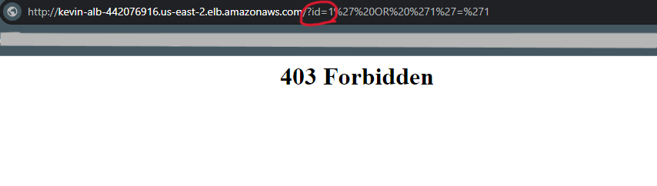
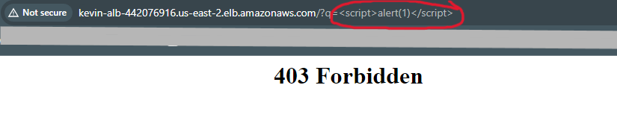
Security Architecture - Ahmad
Security Compliance Policy: https://drive.google.com/file/d/182TTfe5OfXukloLXJqylX4CoXXDMrdFu/view?usp=sharing
Defense-in-Depth & Zero Trust Architecture
MFA + Role Based
End-to-end encryption
Real-Time Alerts
NIST IR 8259
Firewall:
AWS Web Application Firewall
Filter bad requests + known malicious IPs
SQL Injection
Cross-site Scripting

Slide 5
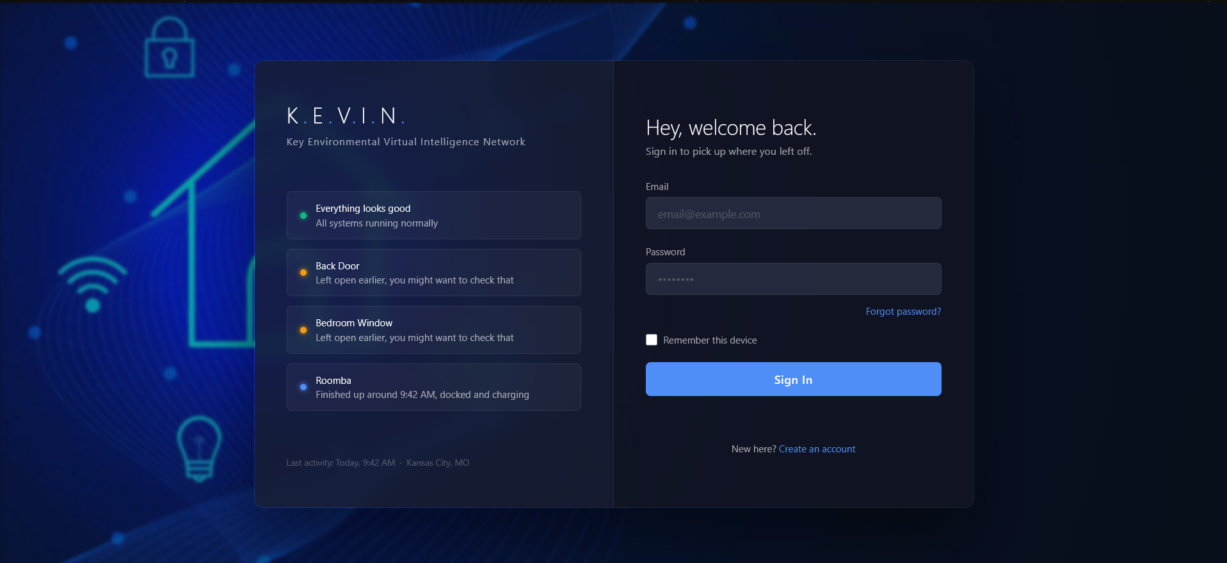
Login Page

Slide 6
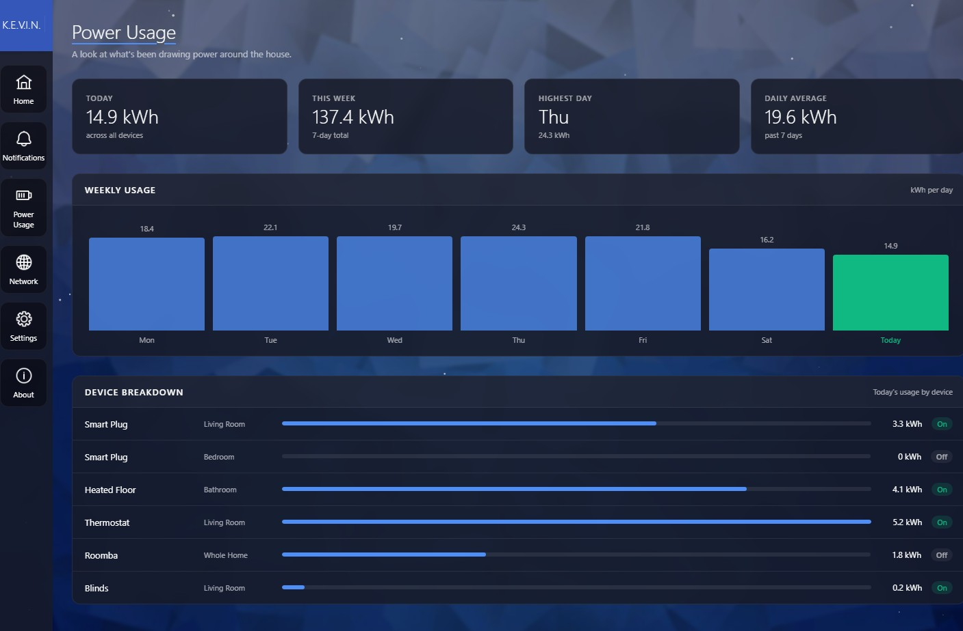
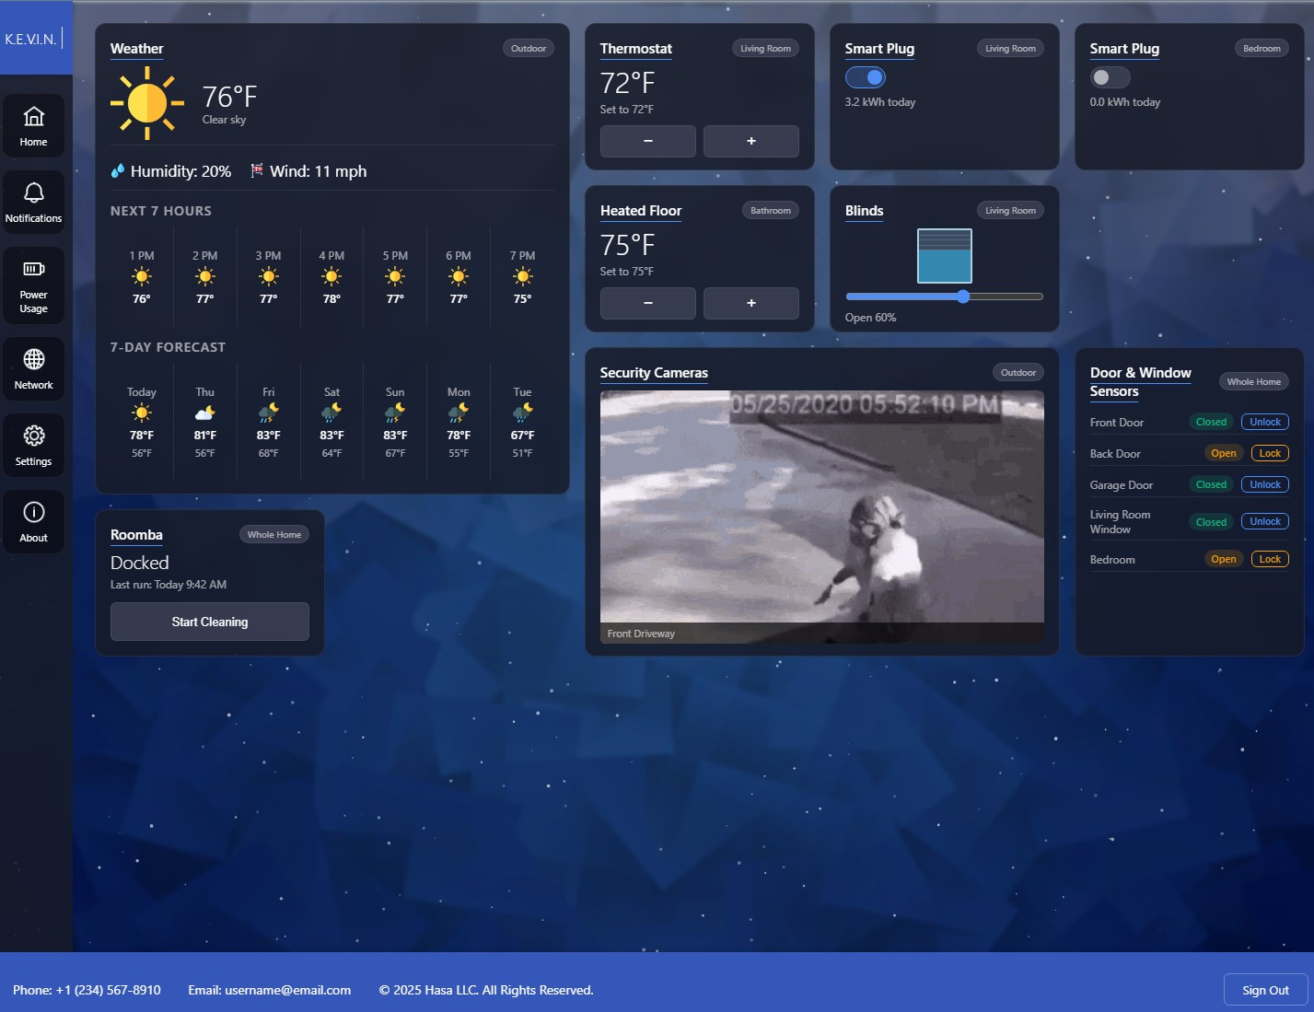
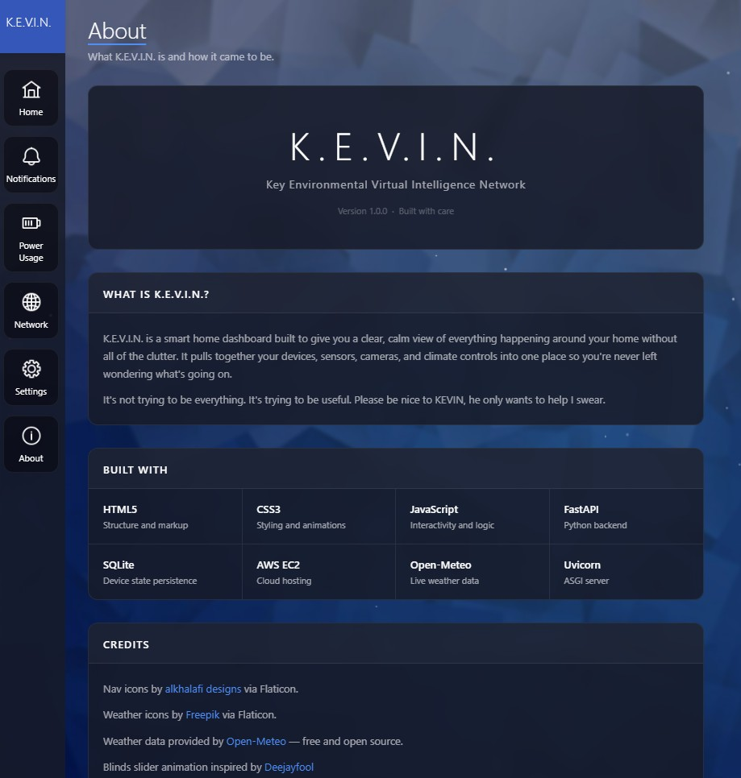
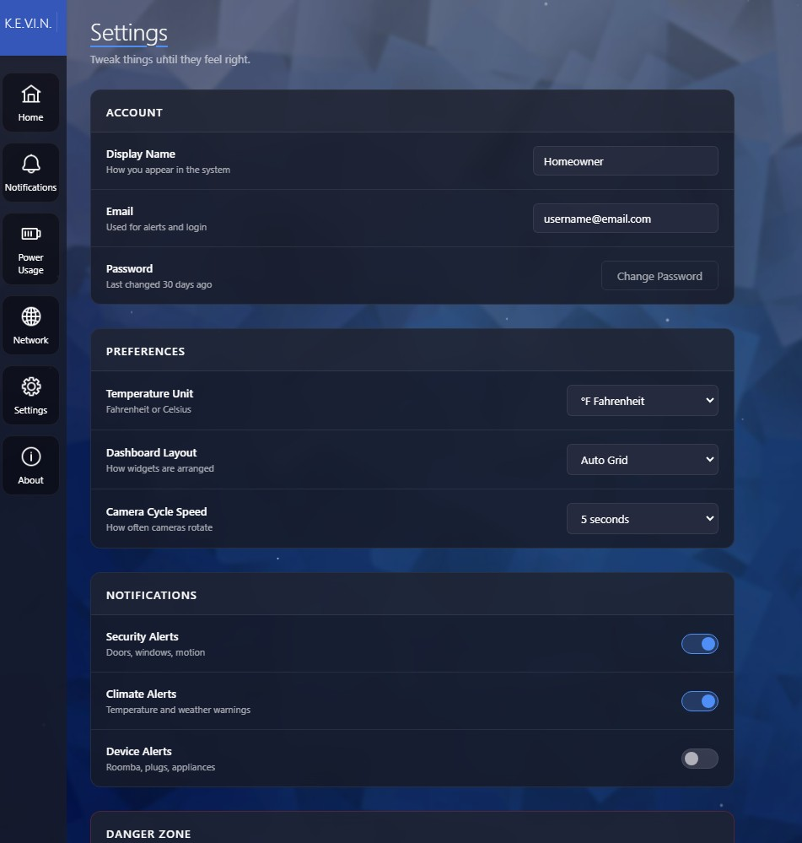
Quick Look at User Interface
Damion & Has
Power Usage
Home Page
About
Settings

Slide 7
Questions?

